Slide 1
Diabetic Retinopathy using Deep Learning

Slide 2
Overview
The diagnosis of diabetic retinopathy (DR) through color fundus images requires experienced clinicians to identify the presence and significance of many small features which, along with a complex grading system, makes this a difficult and time consuming task. In this thesis, I propose a CNN approach to diagnosing DR from digital fundus images and accurately classifying its severity. Tested this CNN architecture and data augmentation which can identify the intricate features involved in the classification task such as micro-aneurysms on the retina and consequently provide a diagnosis automatically and without user input.

Slide 3
What Is Diabetic Retinopathy ?
Due to diabetes, the blood sugar level after increasing by a certain amount start damaging the human eye blood vessels in retina
Sometimes they also can get closed in which case eye will not receive sufficient blood supply which further leads to other forms of abnormalities
Diabetes retinopathy starts to affect eye slowly, if diagnosed early it can be completely cured

Slide 4
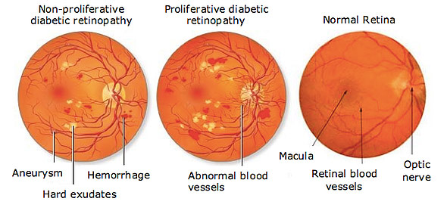
Phases in Diabetic Retinopathy (DR)
Diabetic retinopathy situation of human eye can be broken down into two main stages:
NPDR (non – proliferative diabetic retinopathy) This is the primary stage where few of the blood vessels swell. Sometime they may leak as well or get closed off, both the situation leads to the loss of vision of a patient in later stages.
PDR (proliferative diabetic retinopathy) This is the more advanced stage. In this stage abnormal growth is observed in retina. The newly gown blood vessels are quite fragile and often bleed, which affects the vision and sometimes blocks it as well. The newly grown fragile tissues looks like a scar in the eye.
Figure 1 shows different stages of Diabetic Retinopathy.

Slide 5
Motivation for automation of DR
US Centre of Disease Control and Prevention estimates 29.1 million people suffering from it in US
WHO estimates 347 million around the world has same disease
40-45 % of people that have diabetes are in some stage, which can be averted with timely diagnosis
But the process to identify a DR eye is manual in many parts of the world specially in developing and under developed countries which contributes to more fatalities

Slide 6
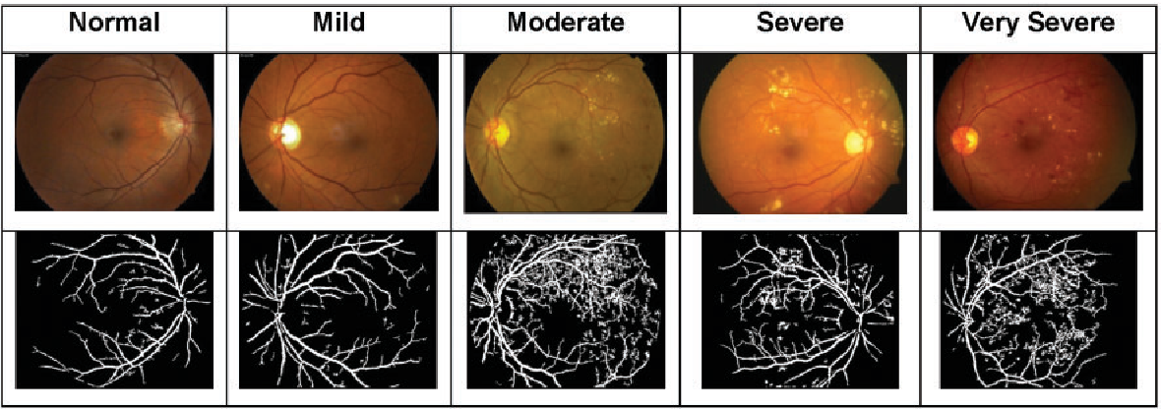
Data Collection & Dataset Used
Color fundus images has to be collected through fundus camera and annotated for various stages of the disease as follows:
1. Normal
2. Mild
3. Moderate
4. Severe
5. Very Severe
Dataset Used : Kaggle - EYEpacs dataset (Freely available for research)

Slide 7
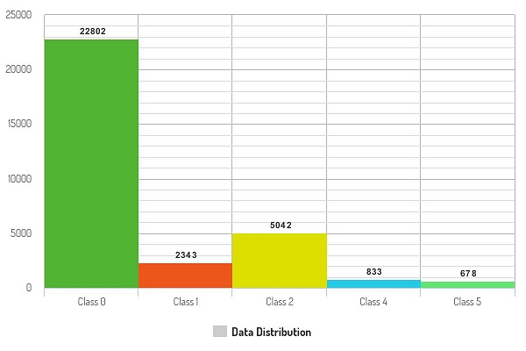
Data Preprocessing – Issues Faced
1. Huge Data Imbalance
Normal | Mild | Moderate | Severe | Very Severe
2. Some of the image qualities are very poor, or even can be said as outlier in few cases. Ex Blurry images, Low Contrast or Brightness images

Slide 8
Data Preprocessing – Solutions of Issues
1. Removing blurry images from classes with excess
2. Contrast and Brightness correction
3. Image data augmentation Ex Cropping, Brightness- Contrast change, log transform to increase images in class which has lesser number
Detailed solutions are described in next few slides

Slide 9
Data Preprocessing – Solutions of Issues
Blurry Image Correction : Variance Of Laplacian
Laplacian of image gives edges present in an image. Blurry images have less edges so variance of edges will be lesser than as compared to sharp images. Thus a well focused image is expected to have a high variation in grey levels.
2. Data Augmentation to increase images of less frequent classes 2.1 Contrast Enhancement Change the image intensity value distribution to cover a wide range Ex Histogram Equalisation 2.2 Log Enhancement The dynamic range of an image can be compressed by replacing each pixel value with its logarithm. This has the effect that low intensity pixel values are enhanced. Applying a pixel logarithm operator to an image can be useful in applications where the dynamic range may too large to be displayed on a screen (or to be recorded on a film in the first place)
2.3 Random Cropping / Rotation / Brightness Change

Slide 10
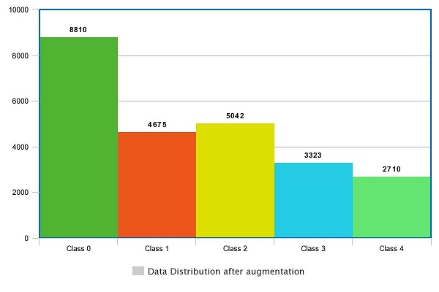
Data Preprocessing – Results
Normal | Mild | Moderate | Severe | Very Severe
Data distribution after Pre-Processing

Slide 11
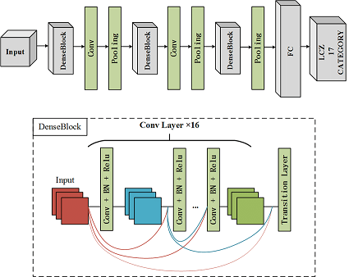
Architecture and Technology Used
1 . FastAI - Deep learning library developed by Howar, Gugger , Thomas
2. torchvision - The torchvision package consists of popular datasets, model architectures, and common image transformations for computer vision
3. DenseNET 201

Slide 12
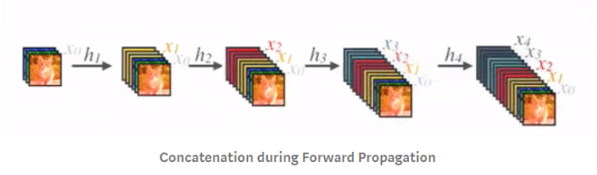
About : DenseNET
1. DenseNet architecture is new, it is a logical extension of ResNet.
2. ResNet architecture has a fundamental building block (Identity) where you merge (additive) a previous layer into a future layer. Reasoning here is by adding additive merges we are forcing the network to learn residuals (errors i.e. diff between some previous layer and current one).
3. In contrast, DenseNet paper proposes concatenating outputs from the previous layers instead of using the summation as shown in figure

Slide 13
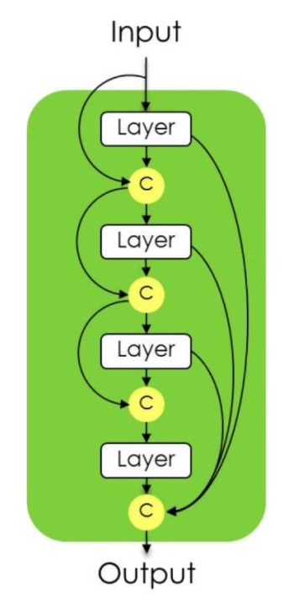
About : DenseNET
1. DenseNet architecture is new, it is a logical extension of ResNet.
2. ResNet architecture has a fundamental building block (Identity) where you merge (additive) a previous layer into a future layer. Reasoning here is by adding additive merges we are forcing the network to learn residuals (errors i.e. diff between some previous layer and current one).
3. In contrast, DenseNET paper proposes concatenating outputs from the previous layers instead of using the summation
For Example :
Diagram of dense block of 4 layers. A first layer is applied to the input to create k feature maps, which are concatenated to the input. A second layer is the applied to create another k feature maps, which are again concatenated to the previous feature maps. The operation is repeated 4 times. The output of the block is the concatenation of the outputs of the 4 layers, and thus contain 4*4 feature maps

Slide 14
Identification of Correct Learning Rate
While retraining our model we used the following concepts of Deep Learning :
1. Data Normalization
By normalizing all of our inputs to a standard scale (-1,1), we're allowing the network to more quickly learn
the optimal parameters for each input node.
2. Weight Decay
When training neural networks, it is common to use "weight decay," where after each update, the weights
are multiplied by a factor slightly less than 1. This prevents the weights from growing too large, and can be
seen as gradient descent on a quadratic regularization term

Slide 15
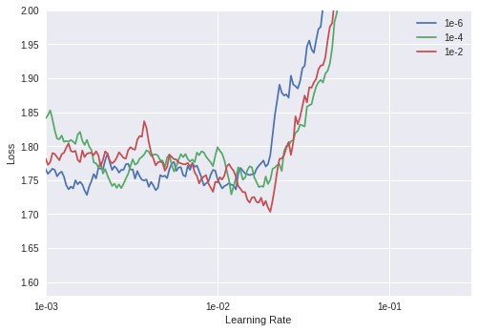
Analysis of Learning Rate
Analysis:
Losses came down most with weight decay 1e-6 and optimal learning rate around
1e-2 but it looks unstable as its keep going up and down
2. Best Learning rate should lie around 1e-3 and 1e-2 and weight decay 1e-6 looks really stable
max_lr = 1e-3 && wd = 1e-6

Slide 16
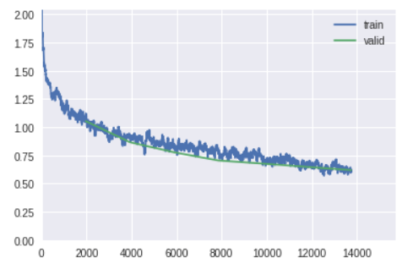
Data Split :
Train : 80 % Validation : 10 % of Train
Test : 20 %
Training and Validation
Accuracy metric : F-Score
epoch | train_loss | valid_loss | accuracy | Time mins
0 | 1.104533 | 1.052842 | 0.621869 | 45:09
1 | 0.920231 | 0.866202 | 0.673997 | 44:55
2 | 0.803812 | 0.777084 | 0.705559 | 45:03
3 | 0.764604 | 0.704630 | 0.733455 | 44:49
4 | 0.691905 | 0.677392 | 0.743637 | 44:47
5 | 0.680551 | 0.648187 | 0.755447 | 44:52
6 | 0.599412 | 0.619531 | 0.768275 | 44:48
Loss Curve w.r.t batches
# 1st cycle
max_lr = 1e-3
wd = 1e-6
learner.fit_one_cycle(cyc_len=8, max_lr=max_lr, wd=wd)

Slide 17
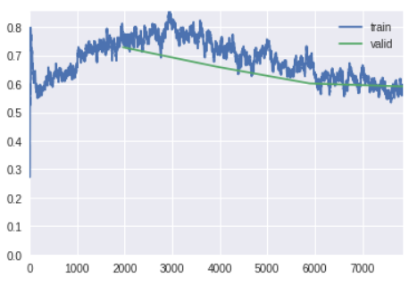
Training and Validation
epoch | train_loss | valid_loss | accuracy | Time mins
0 | 0.757510 | 0.728719 | 0.730605 | 57:43
1 | 0.741443 | 0.660608 | 0.751578 | 57:34
2 | 0.683744 | 0.601534 | 0.767461 | 57:44
3 | 0.596244 | 0.591047 | 0.772551 | 57:55
# 2nd cycle
max_lr =3e-4
max_lrs = [max_lr/9,max_lr/3,max_lr]
wds = [wd/9,wd/3,wd]
wd = 1e-6
learner.unfreeze()
learner.fit_one_cycle(cyc_len=4, max_lr=max_lrs, wd=wds)
Loss Curve w.r.t batches

Slide 18
Training and Validation
epoch | train_loss | valid_loss | accuracy | Time mins
0 | 0.563727 | 0.533711 | 0.794339 | 56:48
1 | 0.590286 | 0.514370 | 0.804724 | 56:09
2 | 0.536467 | 0.500096 | 0.811647 | 56:23
3 | 0.490264 | 0.494299 | 0.813480 | 56:29
# 3rd and Final cycle
max_lr =1e-4
max_lrs = [max_lr/9,max_lr/3,max_lr]
wds = [wd/9,wd/3,wd]
wd = 1e-6
learner.unfreeze()
learner.fit_one_cycle(cyc_len=4, max_lr=max_lrs, wd=wds)
Loss Curve w.r.t batches

Slide 19
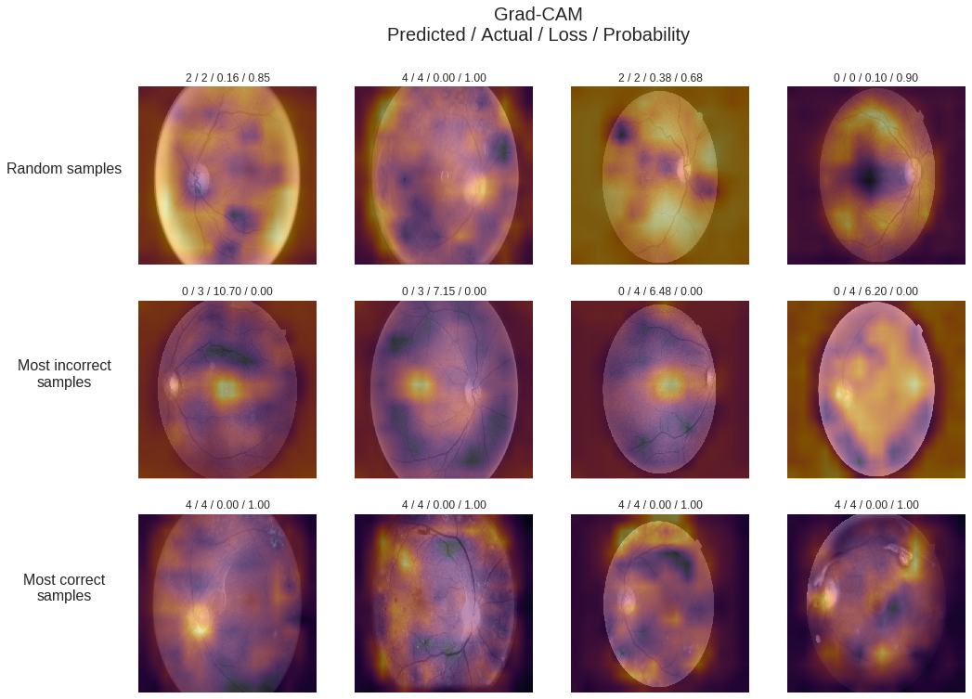
Some Sample Image Results

Slide 20
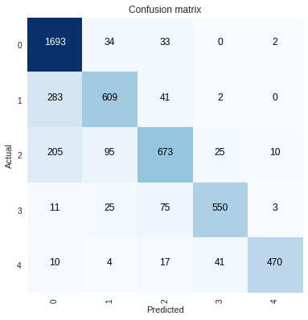
Confusion Matrix and Interpretations
Class/Metric (%) | Precision | Sensitivity/ Recall | F1-Score | Accuracy
Normal | 96.08 | 76.89 | 85.00 | 88.23
Mild | 65.13 | 79.40 | 72.00 | 90.24
Moderate | 66.77 | 80.22 | 73.00 | 90.00
Severe | 82.83 | 89.00 | 86.00 | 96.29
Very Severe | 86.72 | 96.90 | 92.00 | 98.23
Total | 80.00 | 85.00 | 81.6 | 92.6

Slide 21
References
[1] Herbert Bay, Andreas Ess, Tinne Tuytelaars, and Luc Van Gool. 2008. Speeded-Up Robust Features (SURF). Comput. Vis. Image Underst. 110, 3 (June 2008), 346-359. DOI=http://dx.doi.org/10.1016/j.cviu.2007.09.014
[2] Shah AR, Gardner TW. Diabetic retinopathy: research to clinical practice. Clin Diabetes Endocrinol. 2017;3:9. Published 2017 Oct 19. doi:10.1186/s40842-017-0047-y
[3] Gardner TW, Chew EY. Future opportunities in diabetic retinopathy research. Curr Opin Endocrinol Diabetes Obes. 2016;23(2):91–96. doi:10.1097/MED.0000000000000238
[4] Lee R, Wong TY, Sabanayagam C. Epidemiology of diabetic retinopathy, diabetic macular edema and related vision loss. Eye Vis (Lond). 2015;2:17. Published 2015 Sep 30. doi:10.1186/s40662-015-0026-2
[5] Ankita Gupta, Rita Chhikara, Diabetic Retinopathy: Present and Past, Procedia Computer Science, Volume 132, 2018, Pages 1432-1440, ISSN 1877-0509
[6] S. izza Rufaida and M. I. Fanany, “Residual convolutional neural network for diabetic retinopathy,” in Proceedings of IEEE International Conference on Advanced Computer Science and Information Systems (ICACSIS). IEEE, 2017, pp. 367–374.
And more …..

Slide 22
Thank You !!

